Slide 1

MINUTES OF MEETING
AI-Powered Enterprise Meeting Assistant

Slide 2
FYP-II Deliverables?
Important Features Selection
Text Summarization
Web UI
Whole as a System

Slide 3
Important Feature Extractions
Sentences with not words
Sentences with statics
Sentences with date
Sentiment of a sentence and its score
Data extracted from images of meeting notes

Slide 4
Sentences with not words
Sentences containing the word not or it synonyms
Synonyms of NOT : {'no', 'not', 'nay', 'nix', 'never'}
Used regex for matching the string i.e. '^(no|not|nay|nix|never)$
Sentences containing the word with negative prefixes
Negative Prefixes: {'in', 'un', 'non', 'de', 'dis', 'a', 'anti', 'im', 'il', 'ir'}
If the word starts with any of the prefix then check if the remaining word is valid english word (in english dictionary)
Used regex to identify the valid prefix '^(in|un|non|de|dis|anti|a|im|il|ir)\w+$'
Used NLTK.corpus.words library to validate the word

Slide 5
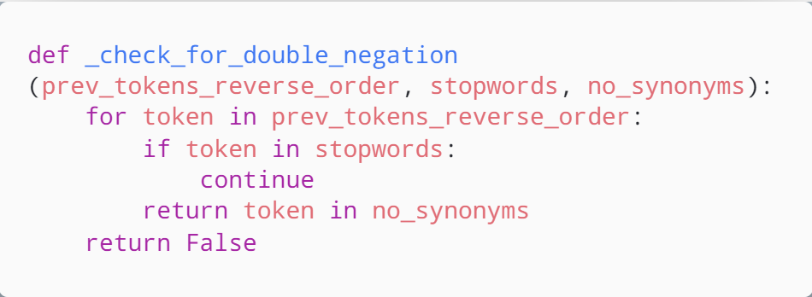
What about Double Negation
Notes:
`

Slide 6
Sentences with statistical value
Sentences containing value in figures
Used regex for matching the statistical figures i.e. '[+-]?[0-9][0-9]*'
Sentences containing the value in words
Can use trie tree to search the pattern
Can use Context Free Grammar to create a parser
Or simple a regex will solve our problem '^(zero|one|two|three|four|five|six|seven|eight|nine|ten|eleven|twelve|thirteen|fourteen|fifteen|sixteen|seventeen|eighteen|nineteen|twenty|thirty|forty|fifty|sixty|seventy|eighty|ninety|hundred|thousand|million|billion|trillion)$

Slide 7
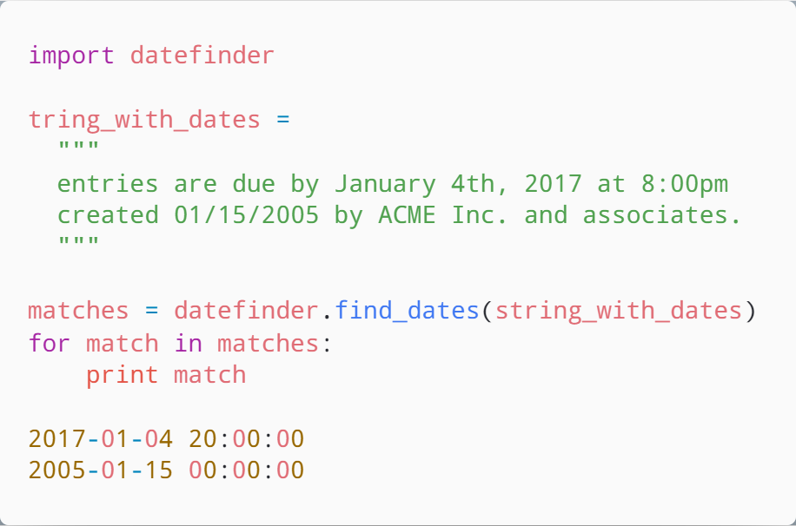
Sentences with Dates
Used python library “datefinder”
Uses regex matching internally to find all possible date combinations

Slide 8
Sentiment of a sentence and its score
Sentences containing value in figures
Used regex for matching the statistical figures i.e. '[+-]?[0-9][0-9]*'
Sentences containing the value in words
Can use trie tree to search the pattern
Can use Context Free Grammar to create a parser
Or simple a regex will solve our problem '^(zero|one|two|three|four|five|six|seven|eight|nine|ten|eleven|twelve|thirteen|fourteen|fifteen|sixteen|seventeen|eighteen|nineteen|twenty|thirty|forty|fifty|sixty|seventy|eighty|ninety|hundred|thousand|million|billion|trillion)$

Slide 9
Text Summarization
Extractive Summarization
Abstractive Summarization

Slide 10
Types of Text Summarization
Extractive Summarization
Rely on extracting several parts, such as phrases and sentences, from a piece of text
stack them together to create a summary
Identifying the right sentences for summarization is of utmost importance in an extractive method
Sentences containing the value in words
Generate an entirely new summary
Some parts of this summary may not even appear in the original text.

Slide 11
TextRank Algorithm
TextRank is an extractive and unsupervised text summarization technique.
The working of TextRank Algorithm is as following:
Concatenate all the text contained in the articles
Split the text into individual sentences
Find vector representation (word embeddings) for each and every sentence
Similarities between sentence vectors are then calculated and stored in a matrix
The similarity matrix is then converted into a graph, with sentences as vertices and similarity scores as edges, for sentence rank calculation
Finally, a certain number of top-ranked sentences form the final summary

Slide 12
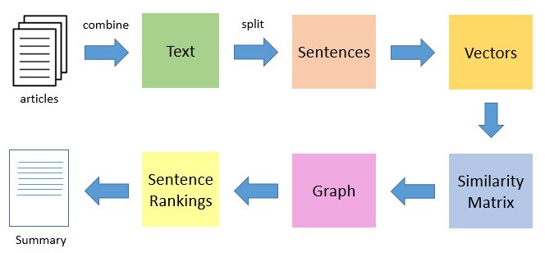
TextRank Algorithm

Slide 13
Interrogative Sentence Detection
S - simple declarative clause, i.e. one that is not introduced by a (possible empty) subordinating conjunction or a wh-word and that does not exhibit subject-verb inversion.
SBAR - Clause introduced by a (possibly empty) subordinating conjunction.
SBARQ - Direct question introduced by a wh-word or a wh-phrase. Indirect questions and relative clauses should be bracketed as SBAR, not SBARQ.
SINV - Inverted declarative sentence, i.e. one in which the subject follows the tensed verb or modal.
SQ - Inverted yes/no question, or main clause of a wh-question, following the wh-phrase in SBARQ.

Slide 14
Interrogative Sentence Classification
Types of Interrogative Sentences
Affirmation (YES or NO)
What
When (Time)
Who (Person)

Slide 15
All Work Done till TODAY

Slide 16
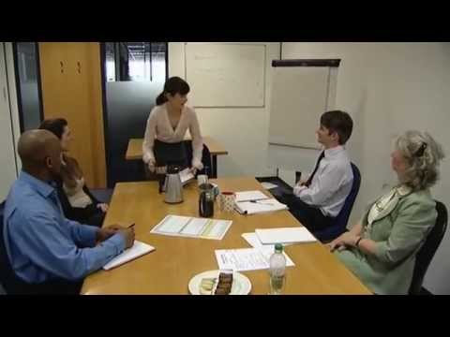
Sample Video
Notes:
https://youtu.be/Ecd9OhMf73k

Slide 17
Result of Speech Transcriber
sentence | speaker | dialogue_id
Shall we start with an update from everyone? | spk_1 | 6
Can we try and keep this to 20 minutes, though? | spk_1 | 7
So we have time for the main | spk_1 | 7
item afterwards. | spk_5 | 8
Maria? | spk_1 | 11
What's happening in the training department this week? | spk_1 | 12
So far, so good. | spk_3 | 13
We have to external trainers in this week. | spk_3 | 13
Notes:
D:\MinutesOfMeeting\meeting-transcript-data-text-parser\venv\data_meeting_text_amazon.csv

Slide 18
Agenda Clustering
sentence | Cluster Index
Shall we start with an update from everyone? | 1
Can we try and keep this to 20 minutes, though? | 2
So we have time for the main | 1
item afterwards. | 2
Maria? | 1
What's happening in the training department this week? | 1
So far, so good. | 3
We have to external trainers in this week. | 5

Slide 19
Sentence Type Classification
sentence | type
Shall we start with an update from everyone? | INTERROGATIVE
Can we try and keep this to 20 minutes, though? | INTERROGATIVE
So we have time for the main | NORMAL
item afterwards. | NORMAL
Maria? | INTERROGATIVE
What's happening in the training department this week? | INTERROGATIVE
So far, so good. | NORMAL
It's not really their decision to go or not. | SUGGESTION
Notes:
D:\MinutesOfMeeting\meeting-transcript-data-text-parser\venv\data_meeting_text_amazon.csv

Slide 20
IMPORTANT FEATURE EXTRACTION
sentence | Not-word found | figure found | Date found | Sentiment type | Sentiment score
Shall we start with an update from everyone? | FALSE | FALSE | FALSE | Neutral | 2
Can we try and keep this to 20 minutes, though? | FALSE | FALSE | TRUE | Negative | 1
So we have time for the main | FALSE | FALSE | FALSE | Neutral | 2
item afterwards. | FALSE | FALSE | FALSE | Neutral | 2
be careful with that one, maria. | FALSE | TRUE | FALSE | Positive | 3
So far, so good. | FALSE | FALSE | FALSE | Positive | 3
It's not really their decision to go or not. | TRUE | FALSE | FALSE | Negative | 1
Notes:
D:\MinutesOfMeeting\meeting-transcript-data-text-parser\venv\data_meeting_text_amazon.csv

Slide 21
FYP II Remaining Deliverables
Complete UI Frontend
Generation of Minutes of Meeting
Integrating Frontend with Backend
Integration and Testing
Documentation

Slide 22
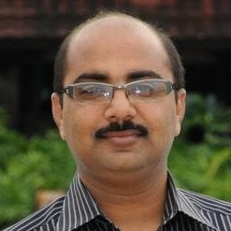

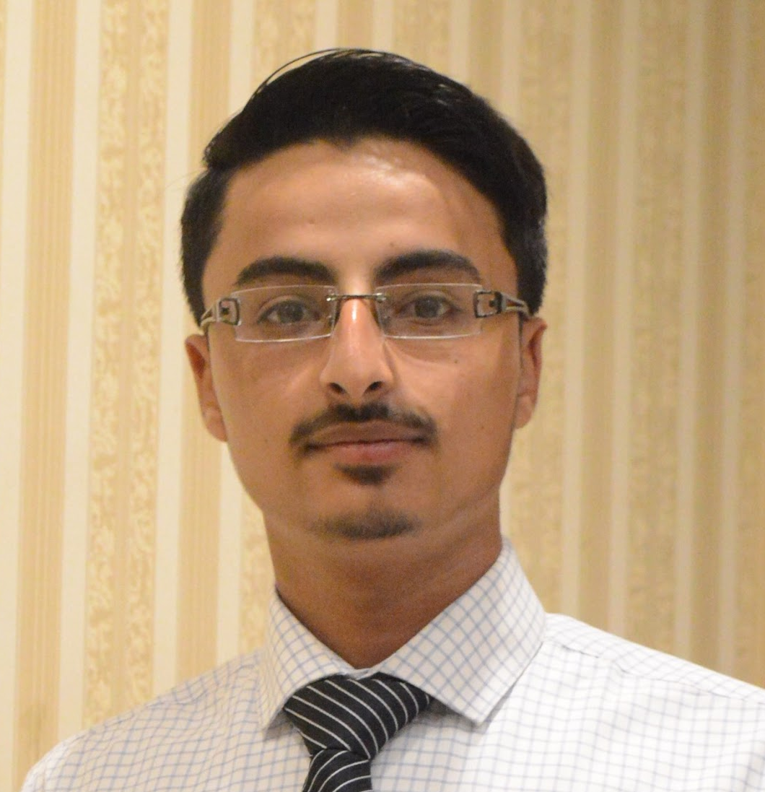

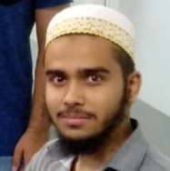
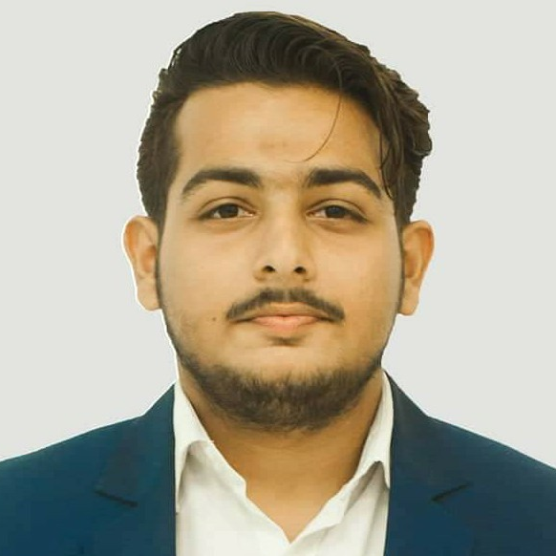
Dr. MUHAMMAD RAFI
Mehdi Raza Rajani
(FYP SUPERVISOR)
Email Address: muhammad.rafi@nu.edu.pk
LinkedIn: muhammad-rafi-34339219
(GROUP LEADER)
Email Address: k163904@nu.edu.pk
GitHub: mehdirazarajani
LinkedIn: mehdirazarajani572
TEAM MEMBERS
Hussain Yousuf
Hussain Yousuf
Shehryar Naeem
Email Address: k163805@nu.edu.pk
GitHub: HussainYousuf
LinkedIn: hussain-yousuf-93c3757
Email Address: k163950@nu.edu.pk
GitHub: shehryarnaeem
LinkedIn: shehryar-naeem-291a3016b

Slide 23
MINUTES OF MEETING
The End
THANK YOU

